Slide 1



OneReach x Oxford ChatGPT Study
Riddhi J. Pitliya
27 Feb 2024

Slide 2
Demographic Information
Total N | 100.00
Males | 60.00
Females | 39.00
Other Gender | 1.00
Mean Age | 38.51
SD Age | 8.12

Slide 3
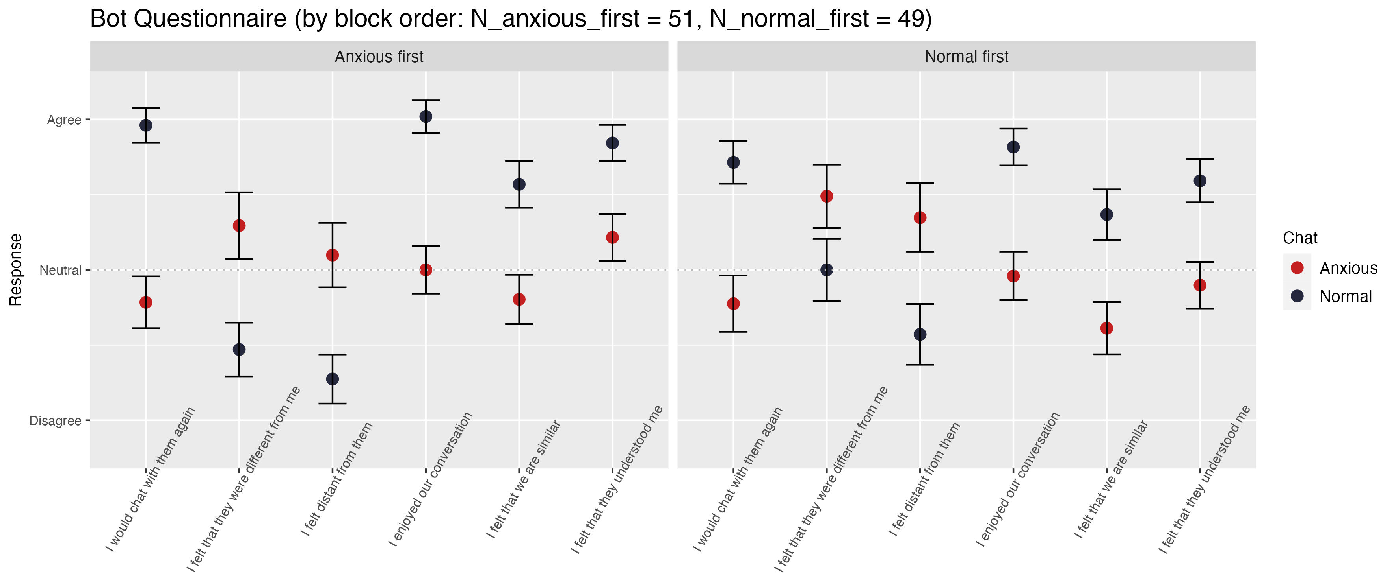
Upon visual inspection, doesn’t seem like there is an effect of block order, so we visualise the results collapsed by block order.

Slide 4
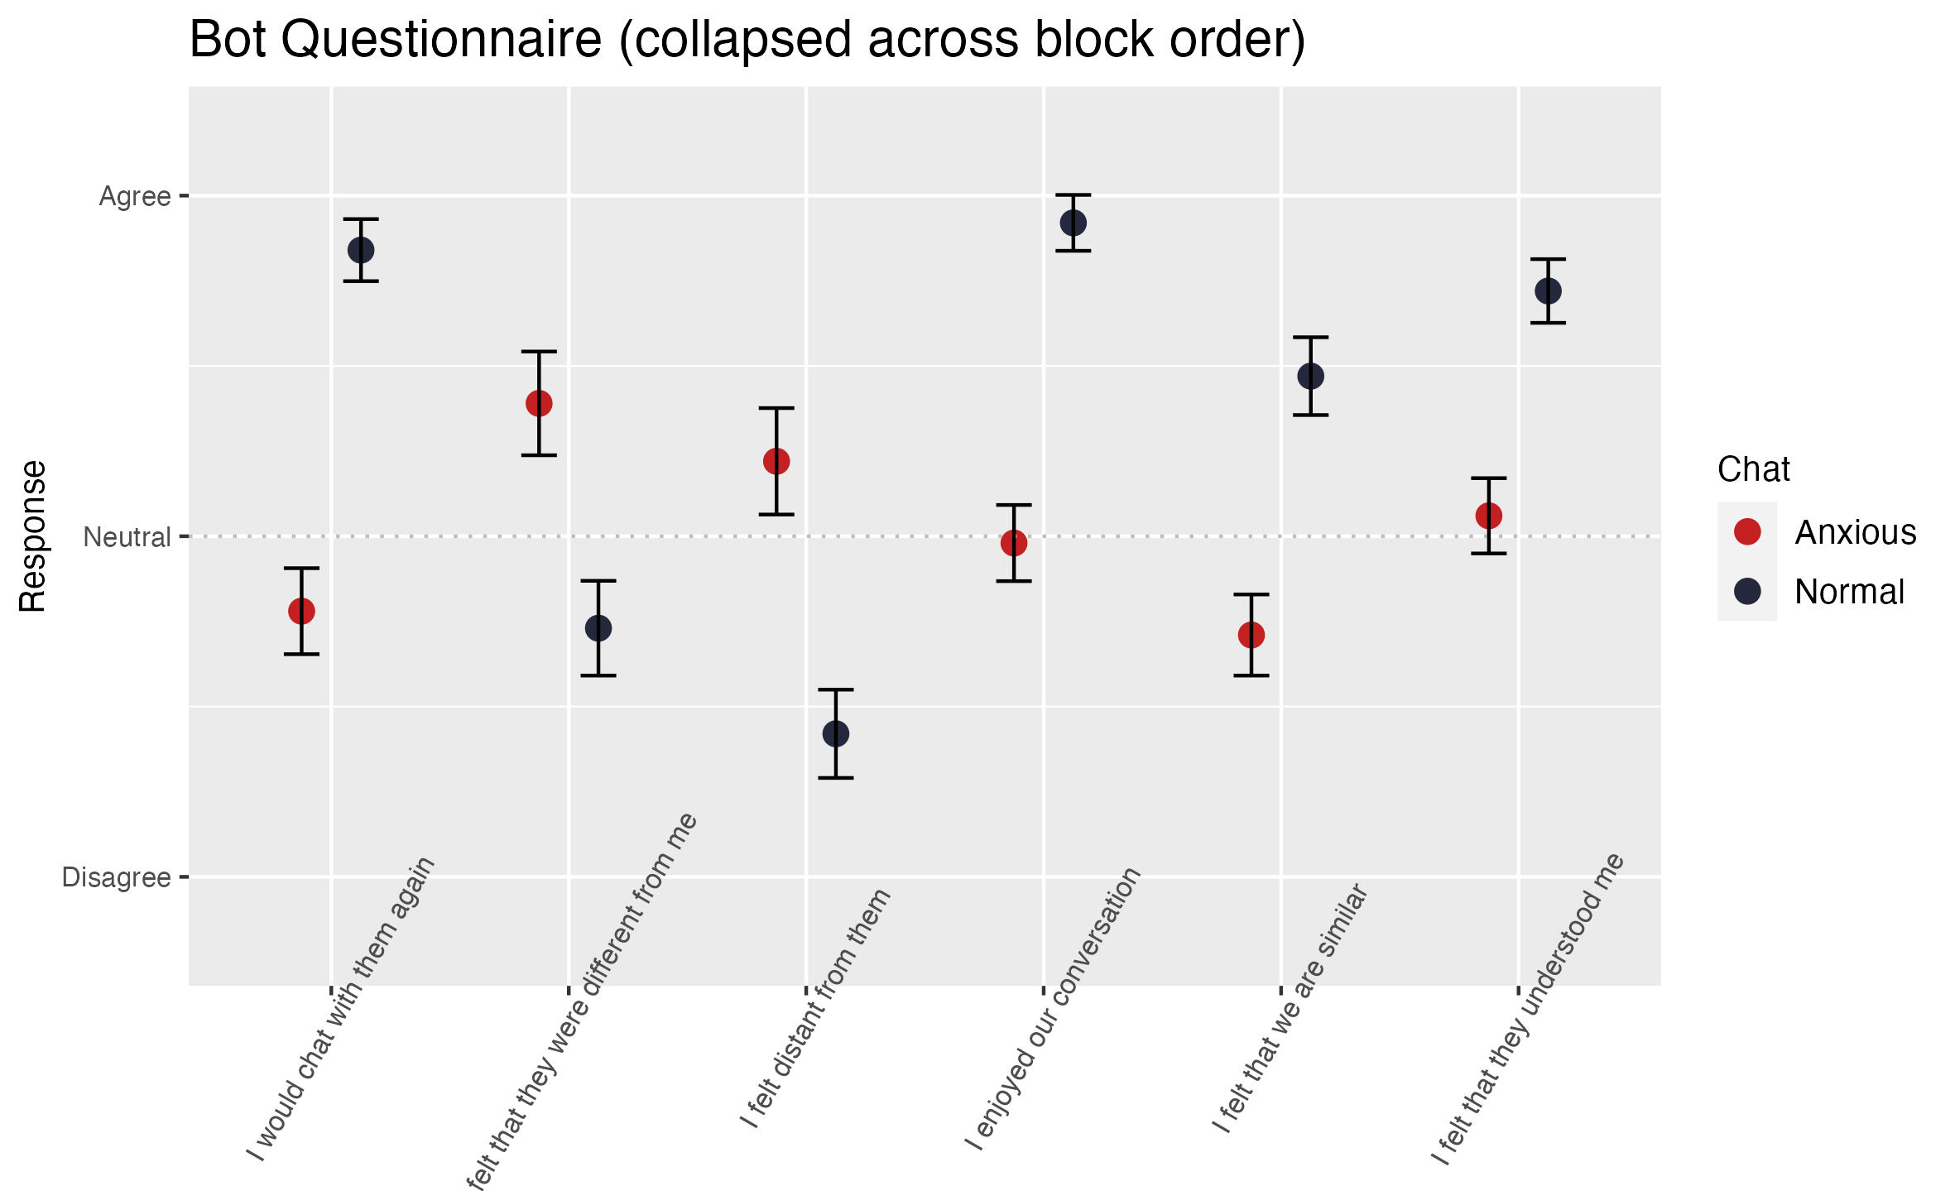
Note that the Response scales from Strongly Disagree to Strongly Agree.

Slide 5
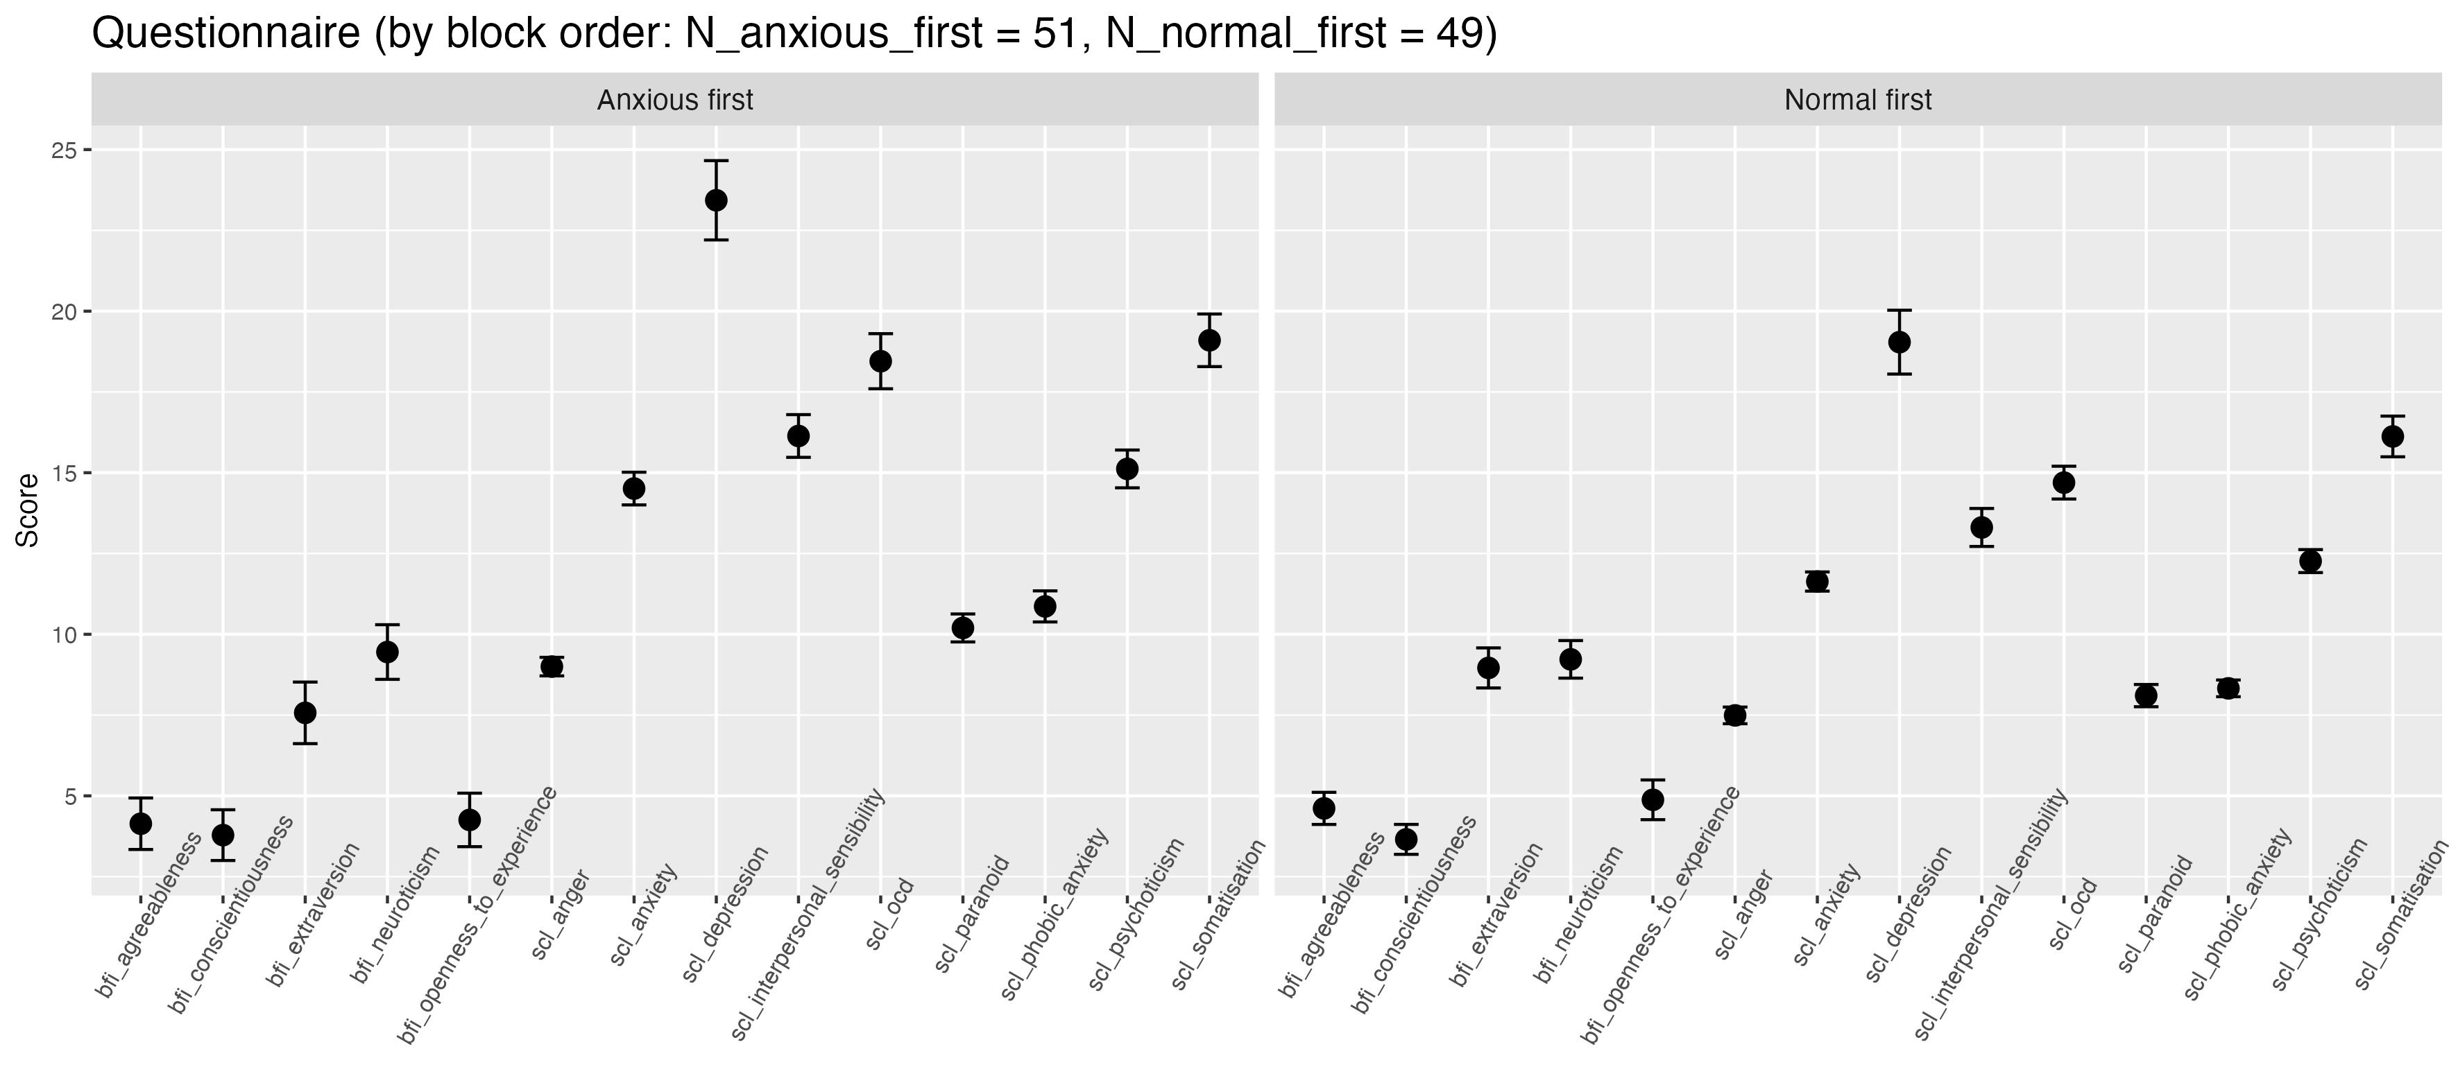
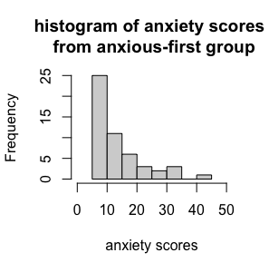
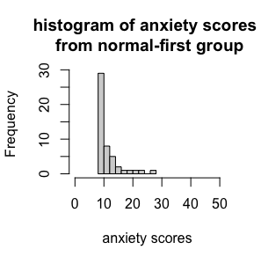
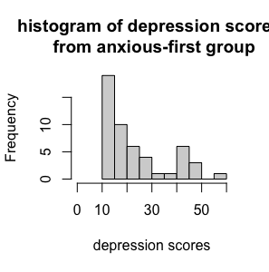
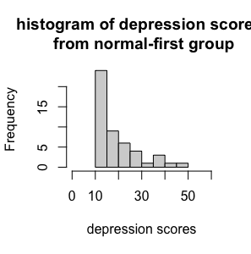
Distributions of Anxiety and Depression Scores

Slide 6
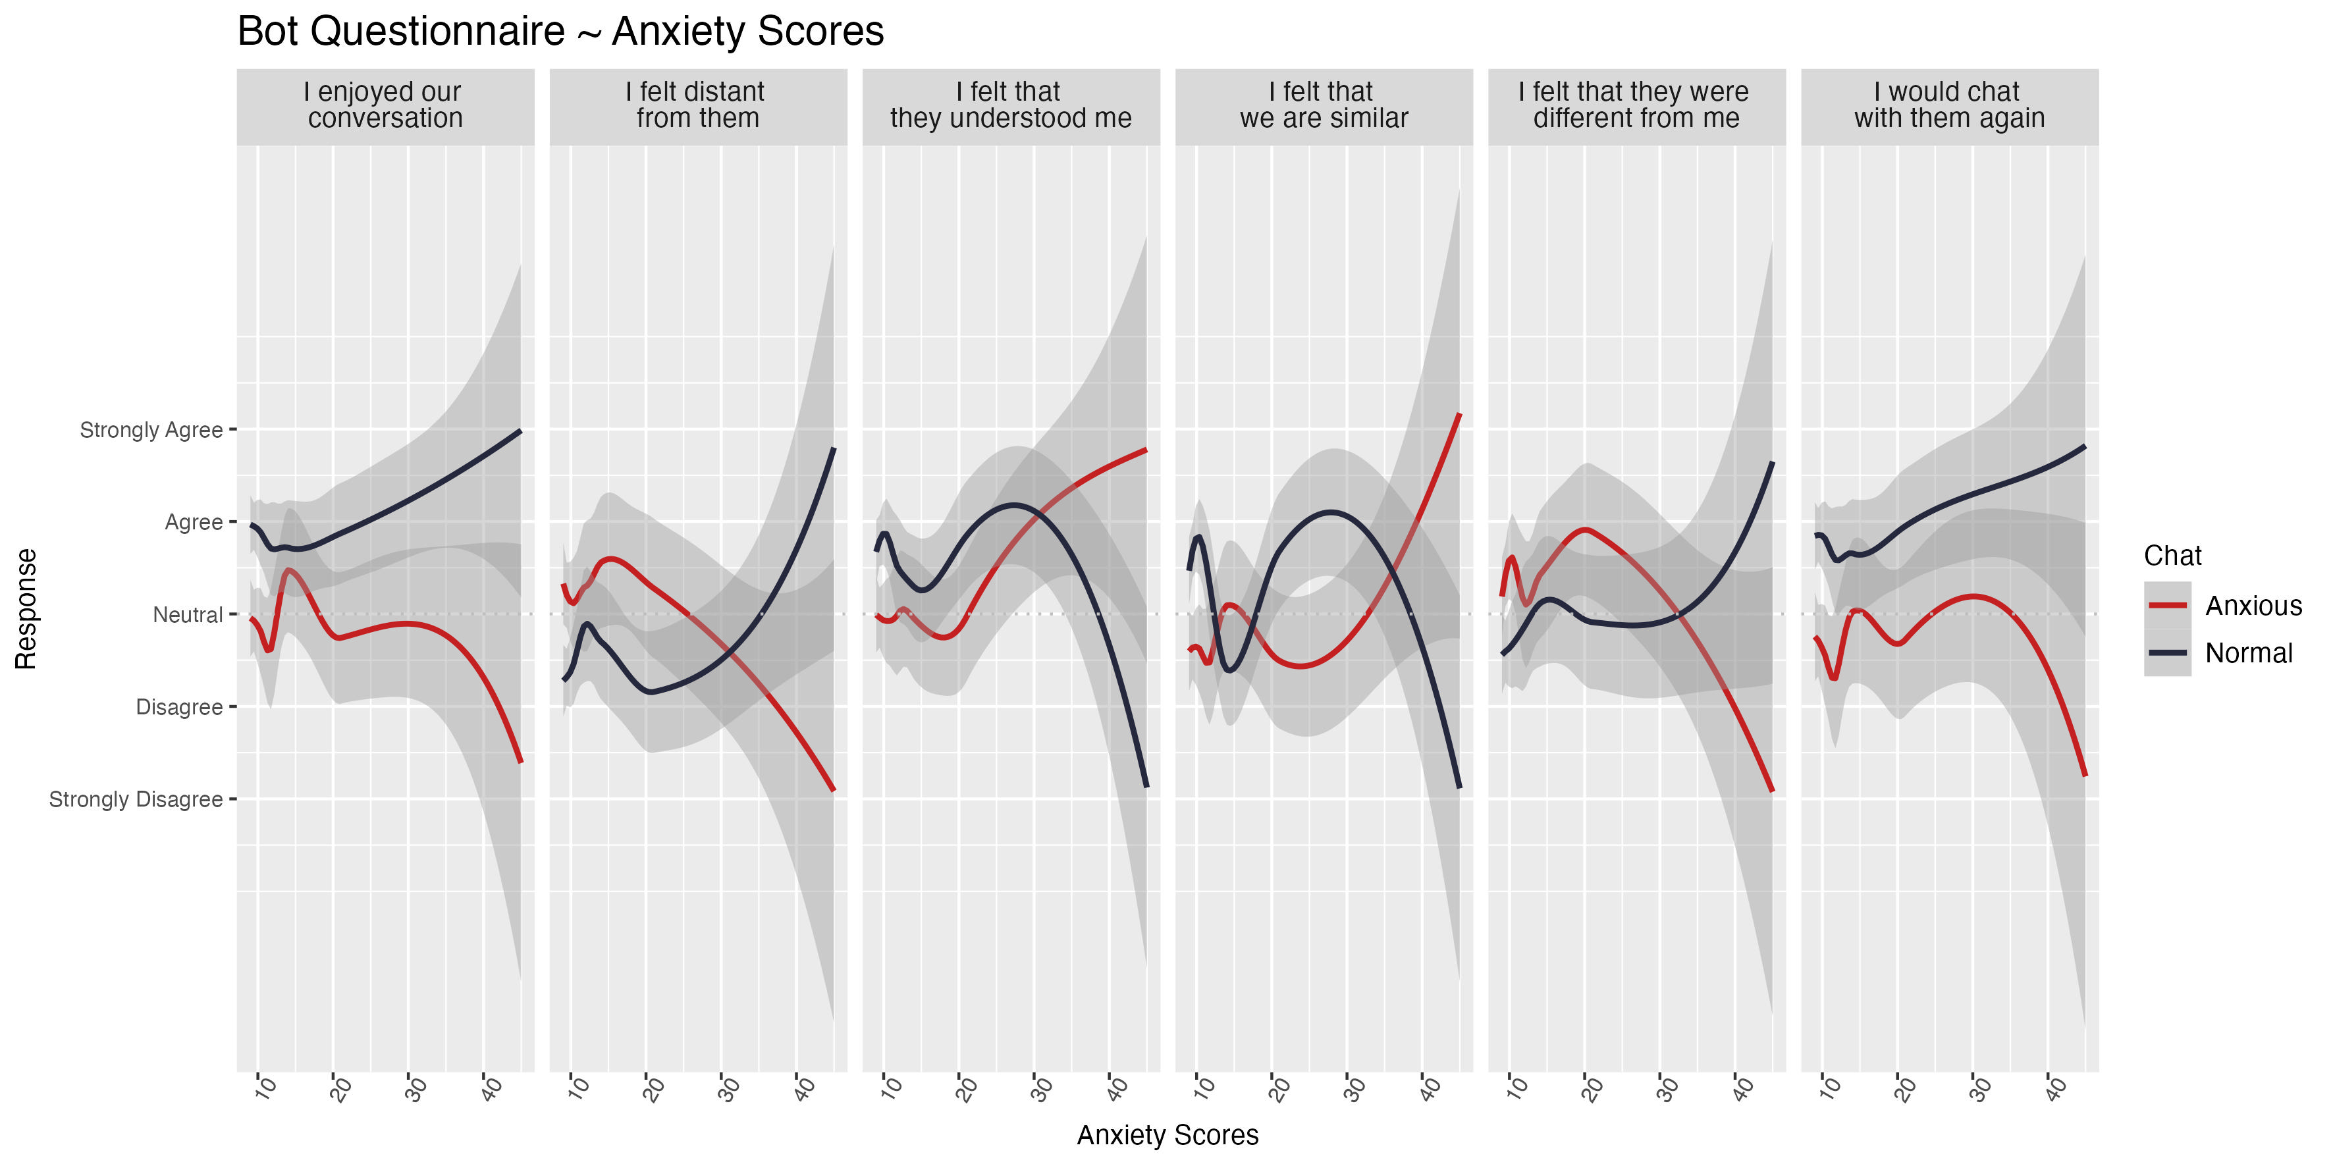

Slide 7
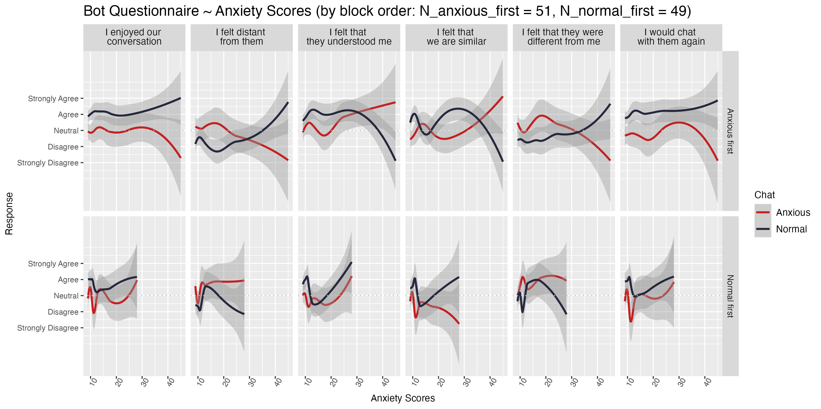

Slide 8
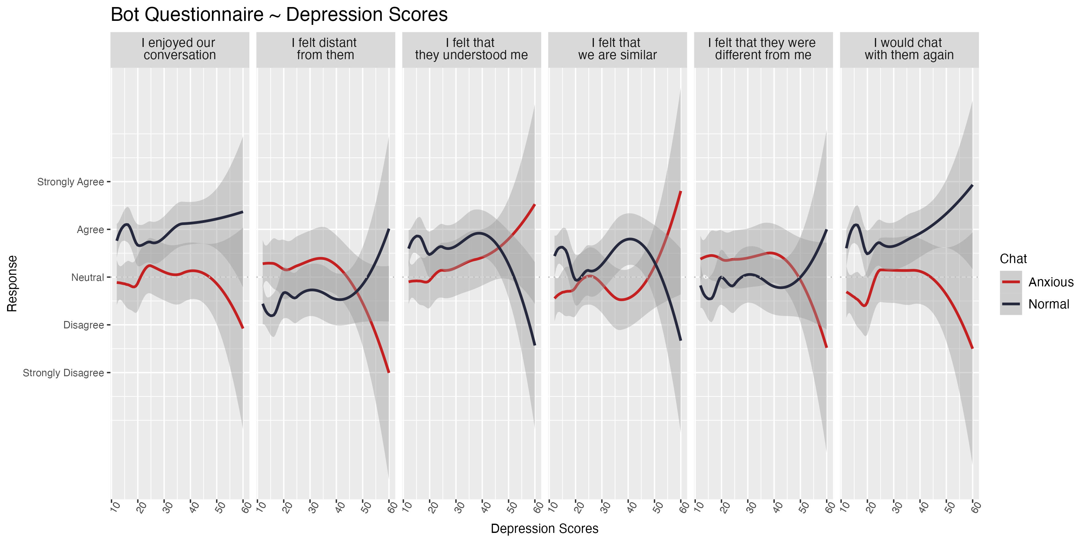

Slide 9
